Slide 1
Probabilistic Graphical Models (II) Inference & Leaning
[70240413 Statistical Machine Learning, Spring, 2018]
Jun Zhu
dcszj@mail.tsinghua.edu.cn
http://bigml.cs.tsinghua.edu.cn/~jun
State Key Lab of Intelligent Technology & Systems
Tsinghua University
May 22, 2018

Slide 2
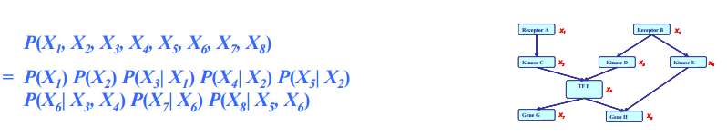
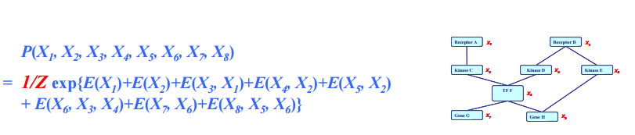
Two Types of PGMs
Directed edges give causality relationships (Bayesian Network or Directed Graphical Models)
Undirected edges give correlations between variables (Markov Random Field or Undirected Graphical Models)

Slide 3
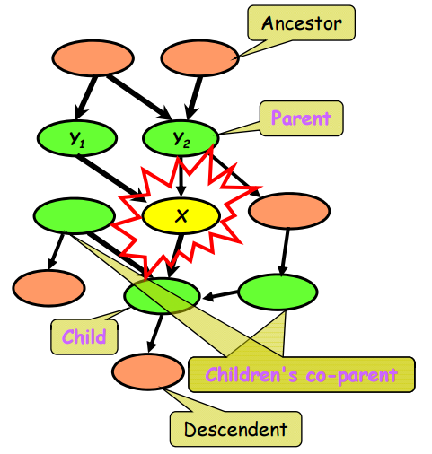
Bayesian Networks
Structure: DAG
Meaning: a node is conditionally independent of every other node in the network outside its Markov blanket
Local conditional distributions (CPD) and the DAG completely determine the joint distribution

Slide 4
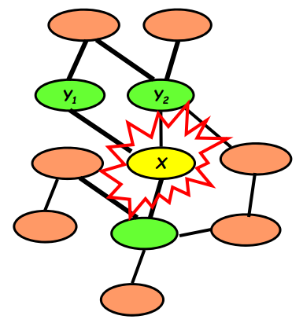
Markov Random Fields
Structure: undirected graph
Meaning: a node is conditionally independent of every other node in the network given its Direct Neighbors
Local contingency functions (potentials) and the cliques in the graph completely determine the joint distribution

Slide 5
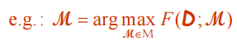
Three Fundamental Questions
We now have compact representations of probability distributions: Graphical Models
A GM M describes a unique probability distribution P
Typical tasks:
Inference
How do I answer questions/queries according to my model and/or based on given data?
Learning
What model is “right” for my data?
Note: for Bayesian, they seek p(M|D), which is actually an inference problem

Slide 6
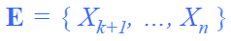
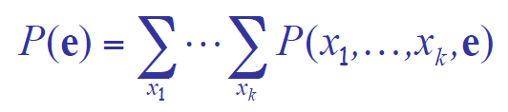
Query 1: Likelihood
Most of the queries one may ask involve evidence
Evidence e is an assignment of values to a set E variables
Without loss of generality
Simplest query: compute probability of evidence

Slide 7
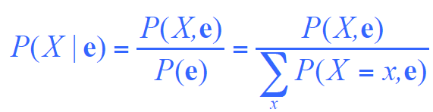
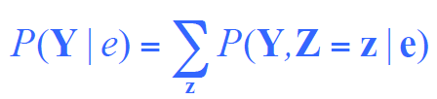
Query 2: Conditional Probability
Often we are interested in the conditional probability distribution of a variable given the evidence
This is the a posterior belief in X, given evidence e
We usually query a subset of Y of all domain variables X={Y,Z} and “don’t care” about the remaining Z:
The resulting p(Y|e) is called a marginal prob.

Slide 8
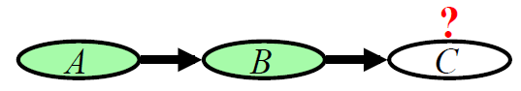
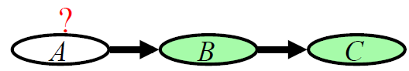
Applications of a posterior belief
Prediction: what is the probability of an outcome given the starting condition
The query node is a descendent of the evidence
Diagnosis: what is the prob of disease/fault given symptoms
The query node is an ancestor of the evidence
Learning under partial observations
Fill in the unobserved values under an “EM” setting
The directionality of info flow between variables is not restricted by the directionality of edges in a GM
Posterior inference can combine evidence from all parts of the network

Slide 9
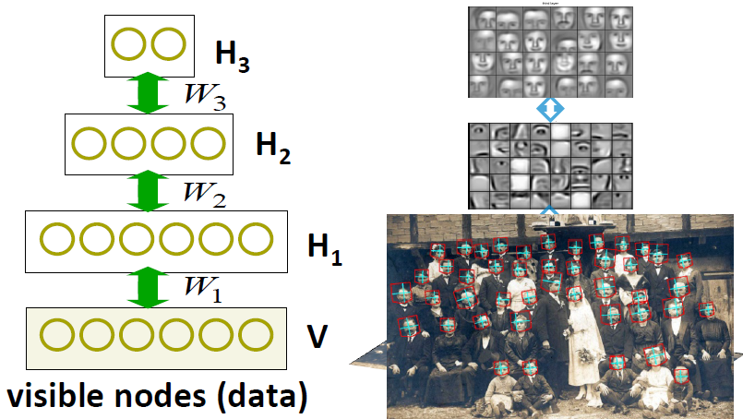
Example: Deep Belief Network
Deep belief network (DBN) [Hinton et al., 2006]
Generative model or RBM with multiple hidden layers
Successful applications: OCR, collaborative filtering, multimodal learning

Slide 10
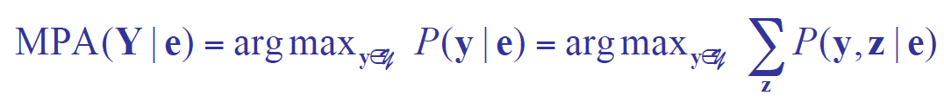
Query 3: Most Probable Assignment
In this query we want to find the most probably joint assignment (MPA) for some variables of interest
Such reasoning is usually performed under some given evidence e and ignoring other variables Z:
This is the maximum a posterior configuration of y.

Slide 11
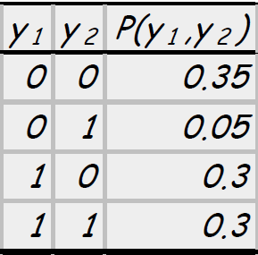
Applications of MPA
Classification:
Find most likely label, given the evidence (input features)
Explanation:
What is the most likely scenario, given the evidence
Cautionary note:
The MPA of a variable depends on its “context” – the set of variables been jointly queried
Example:
MPA of Y₁ ?
MPA of (Y₁ Y₂ )?

Slide 12
Complexity of Inference
Theorem:
Computing P(X=x|e) in a GM is NP-hard
Hardness does not mean we cannot solve inference
It implies that we cannot find a general procedure that works efficiently for arbitrary GMs
For particular families of GMs, we can have provably efficient procedures.

Slide 13
Approaches to Inference
Exact inference algorithms
The elimination algorithm
Message-passing algorithm (sum-product, belief propagation)
The junction tree algorithms
Approximate inference algorithms
Markov chain Monte Carlo methods
Variational methods

Slide 14
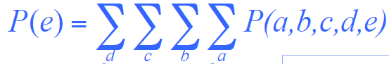
Marginalization and Elimination
A signal transduction pathway
What’s the likelihood that protein E is active?
Query: P(e)
A naive summation needs to enumerate over an exponential # of terms
By chain decomposition, we get

Slide 15
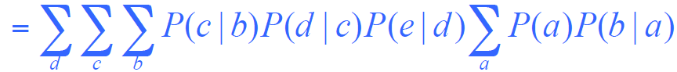
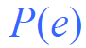
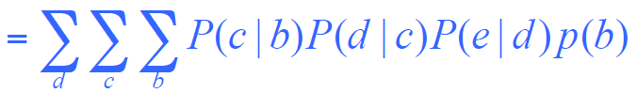
Elimination on Chains
Rearranging terms …
Now, we can perform the innermost summation
This summation “eliminates” one variable from our summation argument at a “local cost”

Slide 16
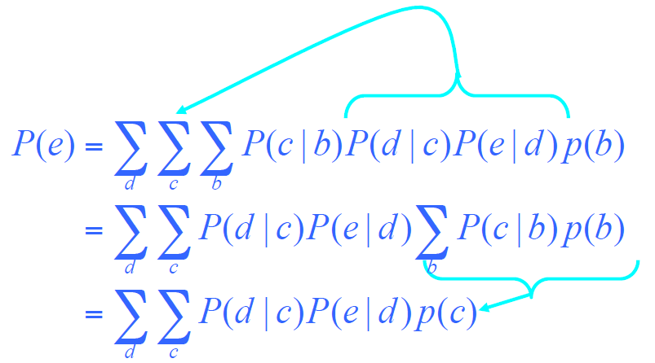
Elimination on Chains
Rearranging and then summing again, we get

Slide 17
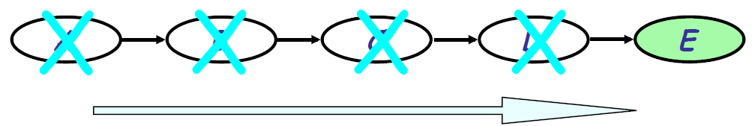
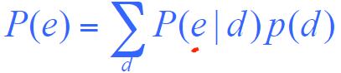
Elimination on Chains
Eliminate nodes one by one all the way to the end, we get
Complexity:
Each step costs operations:
Compare to naive evaluation that sums over joint values of n-1 variables

Slide 18
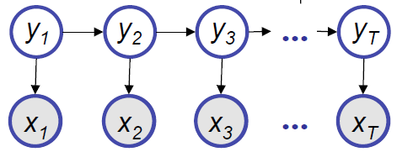
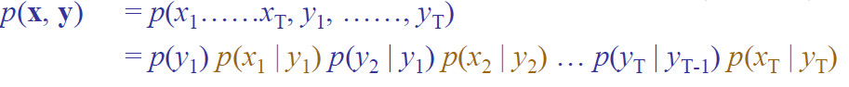
Hidden Markov Model
Now, you can do the marginal inference for HMM:
Answer the query:

Slide 19
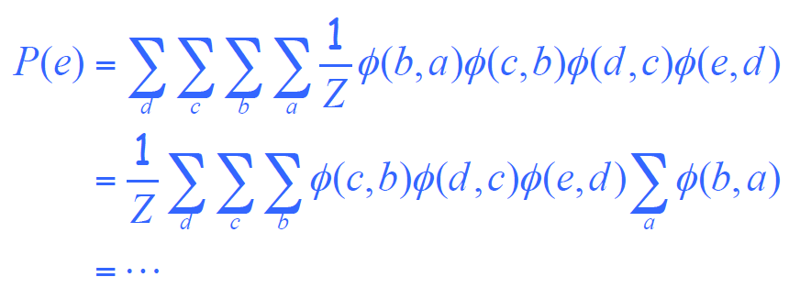
Undirected Chains
Rearranging terms …

Slide 20
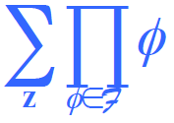
The Sum-Product Operation
In general, we can view the task at hand as that of computing the value of an expression of the form:
where is a set of factors
We call this task the sum-product inference task

Slide 21
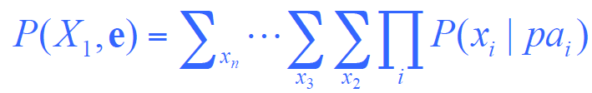
Inference on General GM via VE
General idea of Variable Elimination (VE):
Write query in the form
This suggests an “elimination order” of latent variables
Iteratively:
Move all irrelevant terms outside of innermost sum
Perform innermost sum, getting a new term
Insert the new term into the product

Slide 22
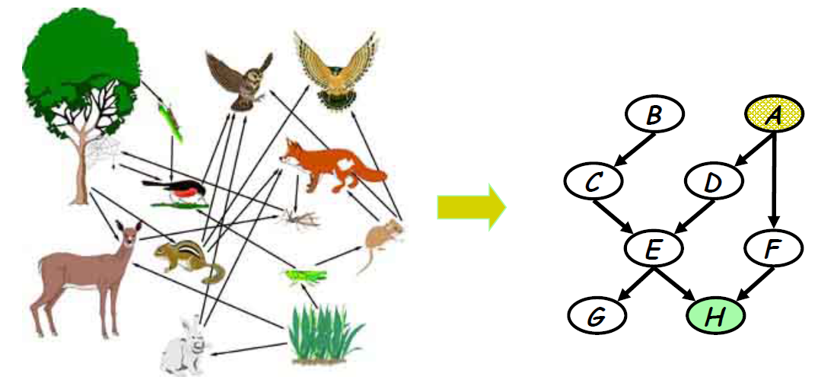
A more complex network
A food web
What is the prob that hawks are leaving given that the grass condition is poor?

Slide 23
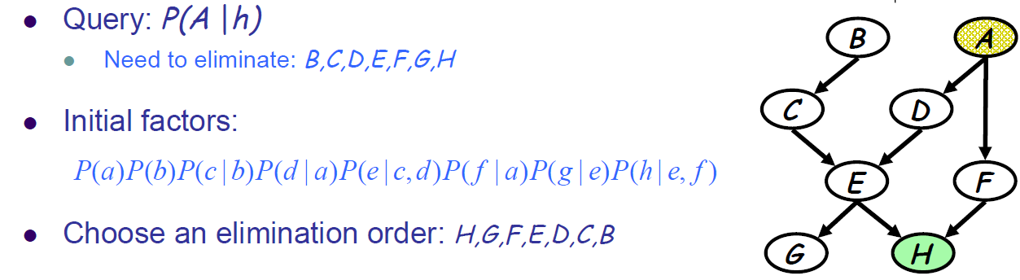
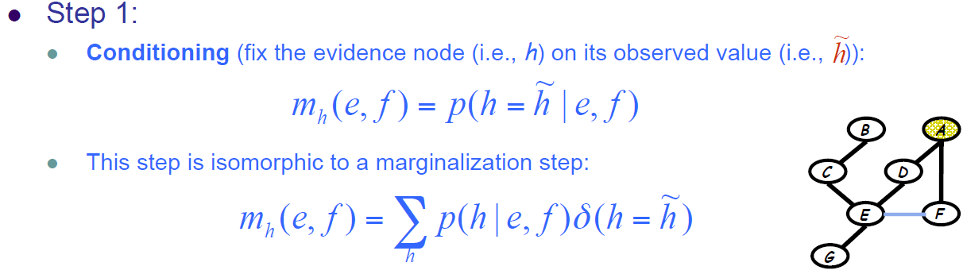
Example: VE

Slide 24
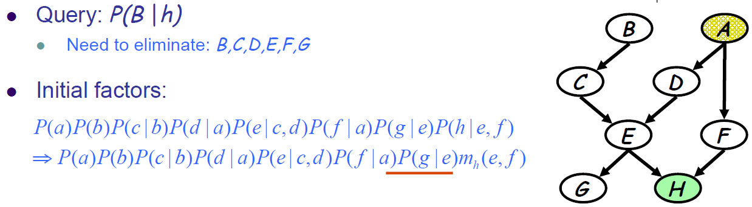

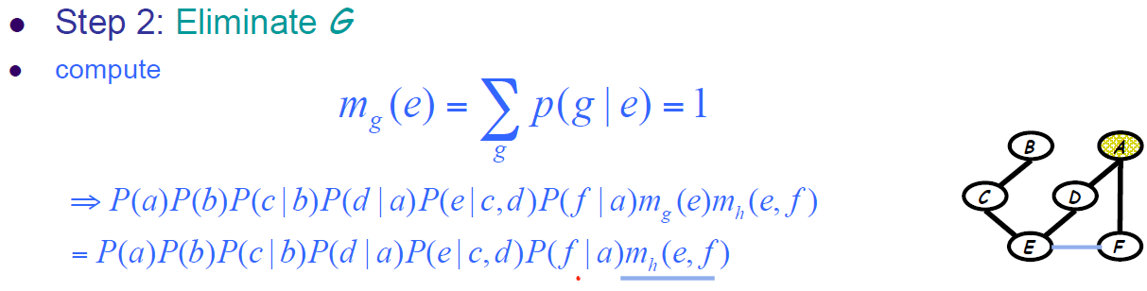
Example: VE

Slide 25
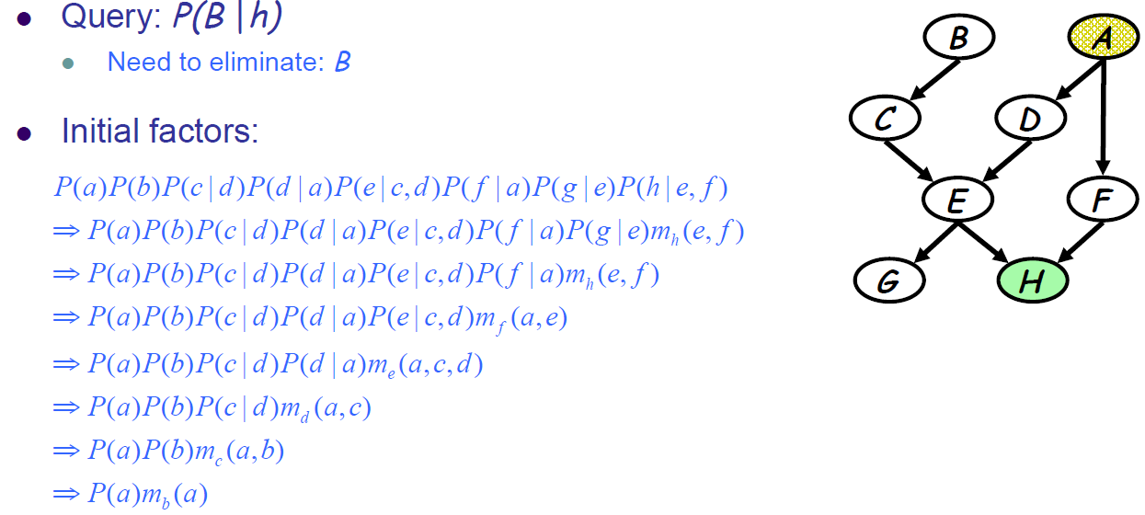
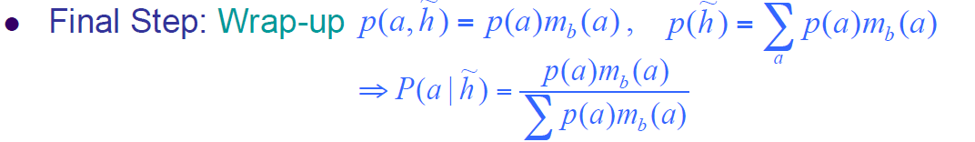
Example: VE

Slide 26
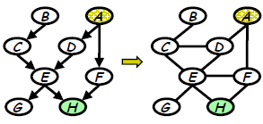
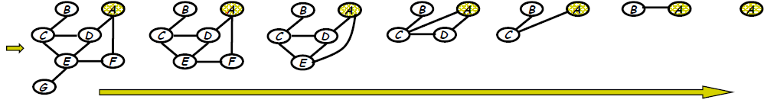
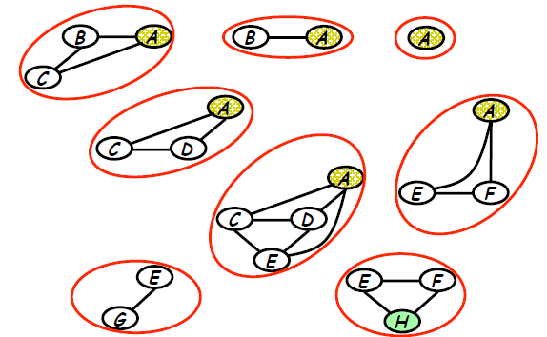
Understanding VE
A graph elimination algorithm
Intermediate terms correspond to the cliques resulted from elimination

Slide 27
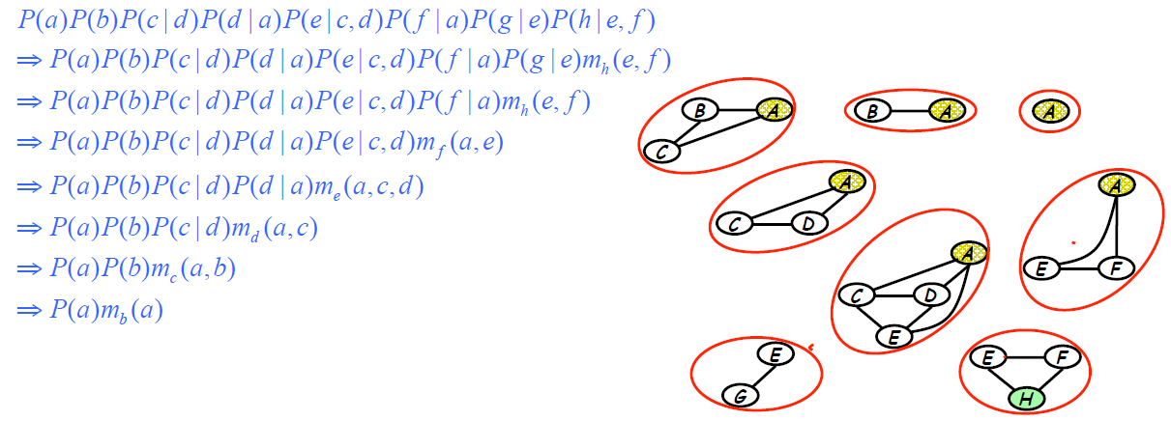
Graph elimination and marginalization
Induced dependency during marginalization
summation ⬄ elimination
intermediate term ⬄ elimination clique

Slide 28
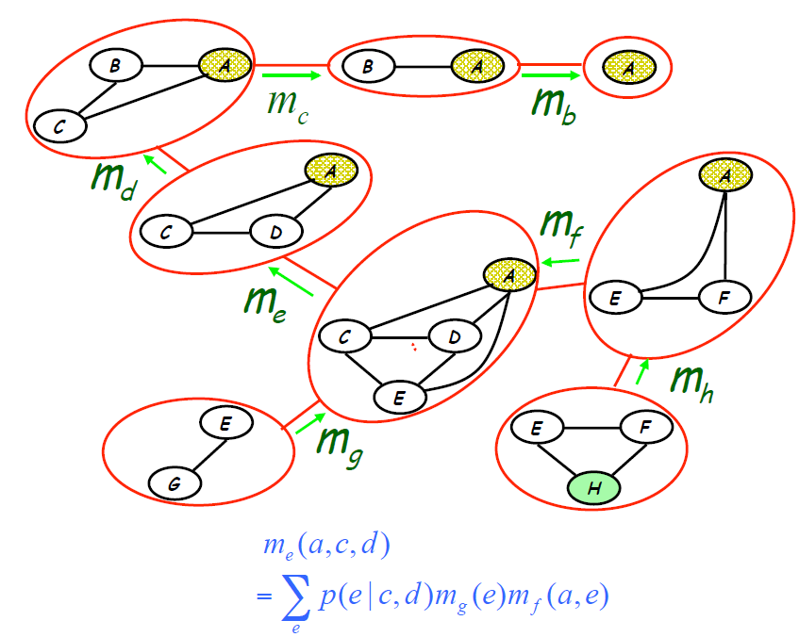
A clique tree

Slide 29
Complexity
The overall complexity is determined by the number of largest elimination clique
What is the largest elimination clique? – a pure graph theory question
“good” elimination orderings lead to small cliques and hence reduce complexity
What if we eliminate “e” first in the above graph?
Find the best elimination ordering of a graph – NP-hard
➔ inference is NP-hard!
But there often exist “obvious” optimal or near-opt elimination ordering

Slide 30
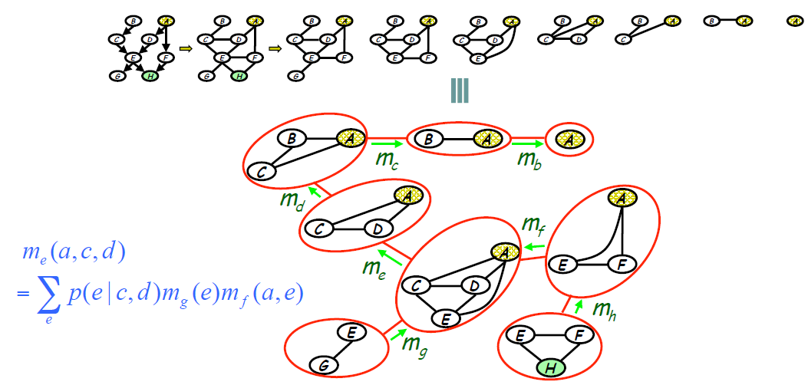
From Elimination to Message Passing
VE answers only one query (e.g., on one node), do we need to do a complete elimination for every such query?
Elimination ⬄ message passing on a clique tree
Messages can be reused!

Slide 31
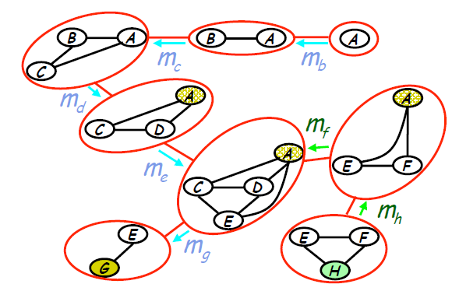
From Elimination to Message Passing
VE answers only one query (e.g., on one node), do we need to do a complete elimination for every such query?
Elimination ⬄ message passing on a clique tree
Another query …

Slide 32
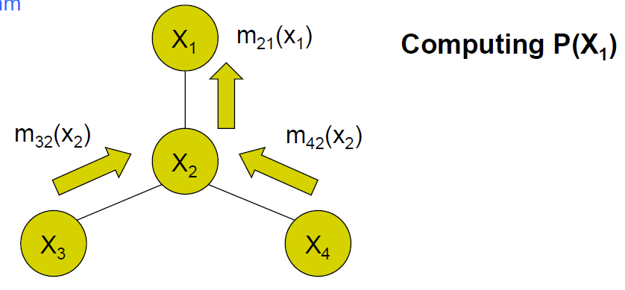
The Message Passing Protocol
A node can send a message to its neighbors when (and only when) it has received messages from all its other neighbors
Computing node marginal:
Naive approach: consider each node as the root and execute message passing

Slide 33
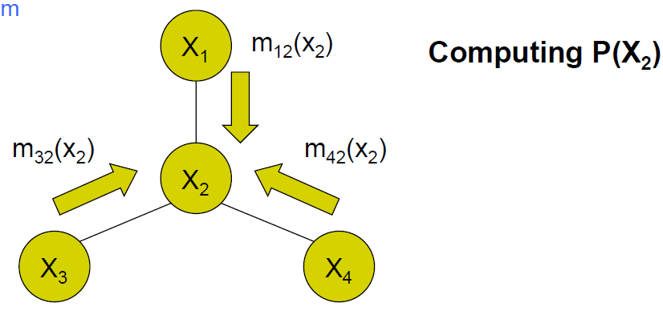
The Message Passing Protocol
A node can send a message to its neighbors when (and only when) it has received messages from all its other neighbors
Computing node marginal:
Naive approach: consider each node as the root and execute message passing

Slide 34
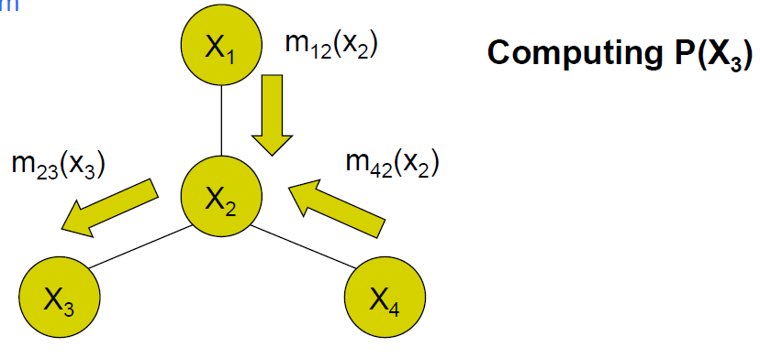
The Message Passing Protocol
A node can send a message to its neighbors when (and only when) it has received messages from all its other neighbors
Computing node marginal:
Naive approach: consider each node as the root and execute message passing

Slide 35
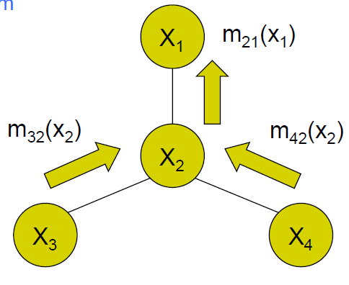
The message passing protocol
A two-pass algorithm

Slide 36
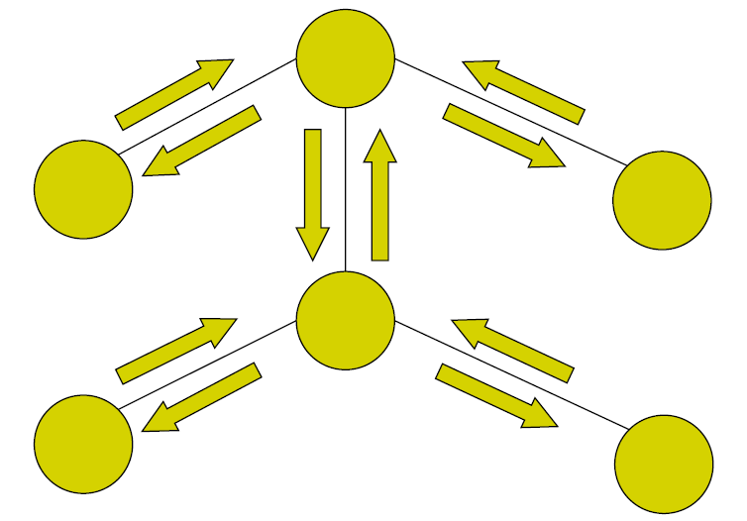
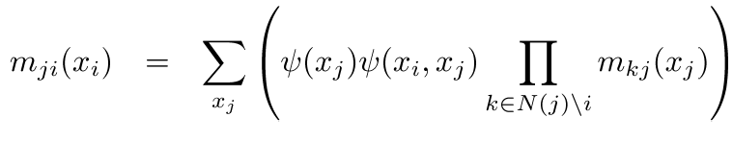
Belief Propagation: parallel synchronous implementation
For a node of degree d, whenever messages have arrived on any subset of d-1 nodes, compute the message for the remaining edge and send!
A pair of messages have been computed for each edge, one per direction
All incoming messages are eventually computed for each node

Slide 37
Correctness of BP for tree
Theorem: the message passing algorithm guarantees obtaining all marginals in the tree

Slide 38
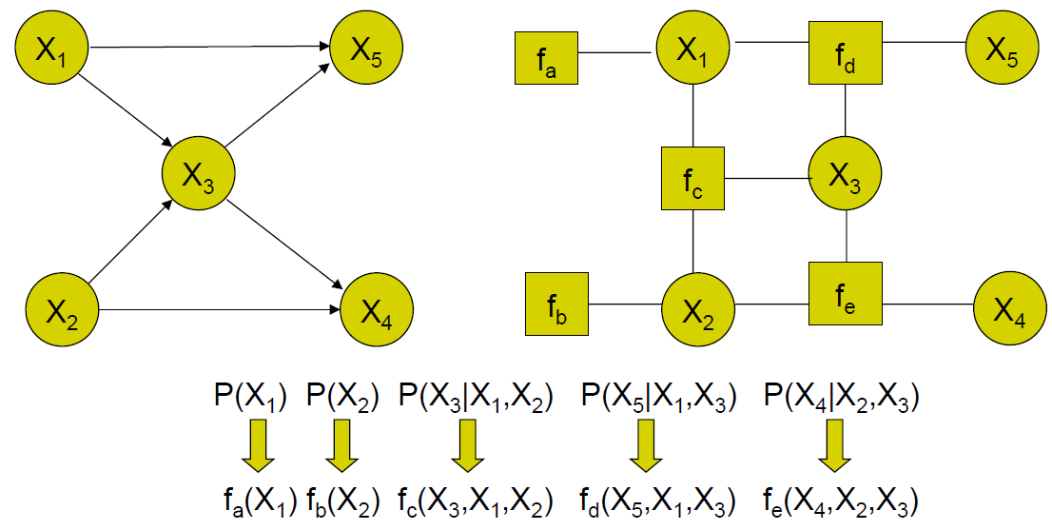
Another view of M-P: Factor Graph
Example 1:

Slide 39
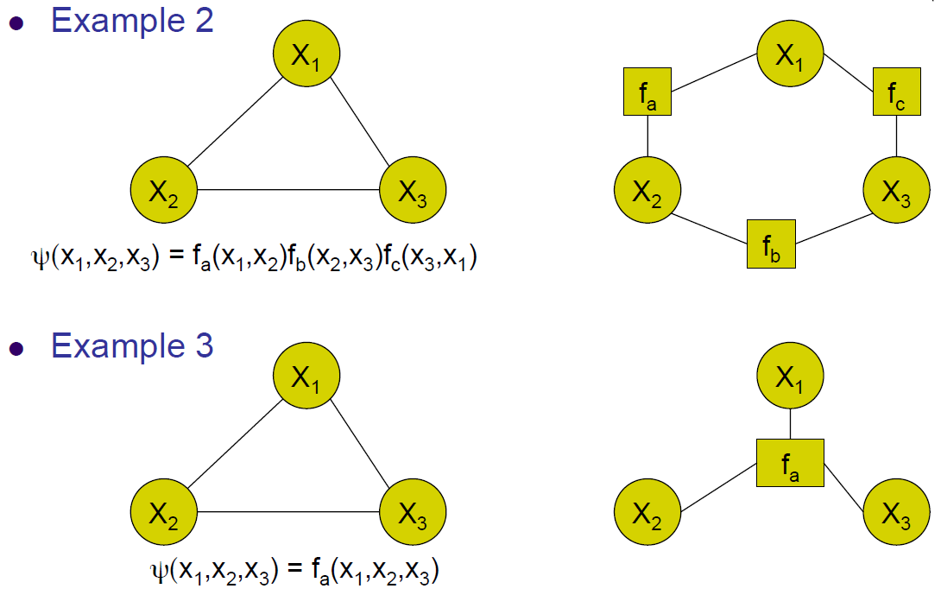
Factor Graphs

Slide 40
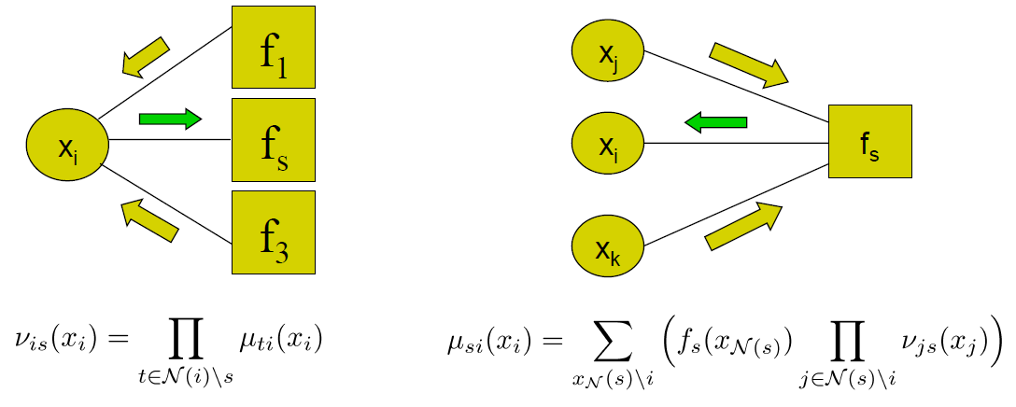
Message Passing on a Factor Tree
Two kinds of messages
From variables to factors
From factors to variables

Slide 41
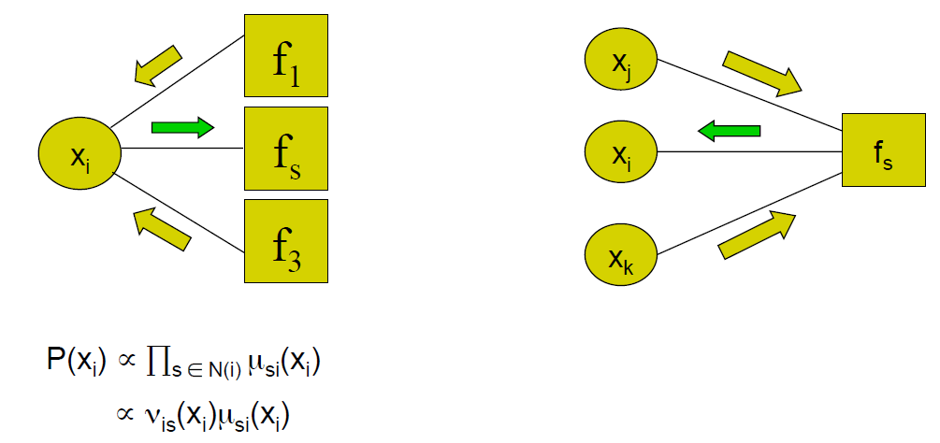
Message Passing on a Factor Tree
Message passing protocol:
A node can send a message to a neighboring node only when it has received messages from all its other neighbors
Marginal probability of nodes

Slide 42

BP on a Factor Tree
Two-pass algorithm:

Slide 43

Why factor graph?
Turn tree-like graphs to factor trees

Slide 44

Why factor graph?
Turn tree-like graphs to factor trees
Trees are a data-structure that guarantees correctness of M-P!

Slide 45

Max-product Algorithm: computing MAP assignment

Slide 46

Max-product Algorithm: computing MAP configurations using a final bookkeeping backward pass

Slide 47
Inference on general GM
Now, what if the GM is not a tree-like graph?
Can we still directly run message-passing protocol along its edges?
For non-trees, we do not have the guarantee that message-passing will be consistent
Then what?
Construct a graph data-structure from P that has a tree structure, and run message-passing on it!
Junction tree algorithm

Slide 48


Junction Tree

Slide 49

Building Junction Tree

Slide 50

An Example

Slide 51
Summary
Sum-product algorithm computes singleton marginal probabilities on
Trees
Tree-like graphs
Maximum a posterior configurations can be computed by replacing sum with max in the sum-product algorithm
Junction tree data-structure for exact inference on general graphs

Slide 52

Learning Graphical Models

Slide 53

Learning Graphical Models

Slide 54

ML Structure Learning for Fully Observed Networks
Two optimal approaches:

Slide 55


Where does the graph structure come from?

Slide 56

Information Theoretical Interpretation of ML
M: # of data samples

Slide 57

Information Theoretical Interpretation of ML
For the fully observable case

Slide 58


Structural Search
How many graphs over n nodes?
How many trees over n nodes?
But it turns out that we can find exact solution of an optimal tree (under MLE)!
Trick: in a tree each node has only one parent!
Chow-Liu algorithm (1968)

Slide 59


Chow-Liu tree learning algorithm
Objective function
Chow-Liu algorithm:

Slide 60

Chow-Liu tree learning algorithm
Objective function
Chow-Liu algorithm:

Slide 61

Structure Learning for General Graphs

Slide 62
ML Parameter Est. for
fully observed Bayesian Networks of
given structure

Slide 63

Parameter Learning

Slide 64



Recall Density Estimation
Can be viewed as a single-node graphical model
Instances of exponential family dist.
Building block of general GM
MLE and Bayesian estimate
Recall the example of Bernoulli distribution
MLE gives count frequency
Bayes introduces pseudo-counts

Slide 65

Recall Conditional Density Estimation
Can be viewed as two-node graphical models
Instances of GLIM
Building blocks of general GM
MLE and Bayesian estimate
Recall example of logistic regression
We talked about the MLE
Bayesian estimate is a bit involved (due to non-conjugacy). We’ll come to it in GPs

Slide 66

MLE for general BNs
If we assume the parameters for each CPD are globally independent, and all nodes are fully observed, then the log-likelihood decomposes into a sum of local terms, one per node:

Slide 67


Decomposable likelihood of a BN
Consider the distribution defined by the directed acyclic GM:
This is exactly like learning four separate small BNs, each of which consists of a node and its parents

Slide 68







MLE for BNs with tabular CPDs
Assume each CPD is represented as a table (multinomial) where
Note that in case of multiple parents, will have a composite state, and the CPD will be a high-dimensional table
The sufficient statistics are counts of family configurations
The log-likelihood is

Slide 69

Bayesian Estimate for BNs
How to define a parameter prior?
Assumptions (Geiger & Hecherman, 1997)
Global parameter independence
Local parameter independence

Slide 70





Parameter Sharing
Consider a time-invariant (stationary) 1st-order Markov model
Initial state probability vector
State transition probability matrix
The joint distribution:
Log-likelihood
Again, we optimize each parameter separately
We have seen how to estimate . What about A?

Slide 71


Learning a Markov chain transition matrix
A is a stochastic matrix
Each row of A is multinomial distribution
So, MLE of is the fraction of transitions from i to j:
Application:
If the states represent words, this is called a bigram language model
Data sparsity problem:
If didn’t occur in data, we have , then any future sequence with word pair will have zero probability
A standard hack: backoff smoothing

Slide 72


Bayesian language model
Interpreted as a Bayesian language model
If assign a Dirichlet prior to each row of the transition matrix
We have

Slide 73
Example: HMMs
Supervised learning: estimation when the “right answer” is known
Example:
the casino player allows us to observe him one evening, as he changes dice and produces 10,000 rolls
Unsupervised learning: estimation when the “right answer” is unknown
Example:
10,000 rolls of the casino player, but we don’t see when he changes dice
Question: update the parameters of the model to maximize likelihood

Slide 74

Definition of HMM

Slide 75

Supervised MLE
Be aware of the zero-count problem!

Slide 76
Summary: Learning BNs
For fully observed BN, the log-likelihood function decomposes into a sum of local terms, one per node; thus learning is also factored
Structure learning
Chow-Liu;
Neighborhood selection (later)
Learning single-node GM – density estimation: exponential family distribution
Learning two-node BN: GLIM
Learning BN with more nodes
Local operations

Slide 77
ML Parameter Est. for
fully observed Markov Random Fields of
given structure

Slide 78


MLE for Undirected Graphical Models
What we have known
For directed GMs, the log-likelihood decomposes into a sum of terms, one per family (node plus parents)
However, for undirected GMs, the log-likelihood does NOT decompose!
In general, we will need to do inference (i.e., marginalization) to learn parameters for undirected GMs, even in the fully observed case

Slide 79



Log-likelihood for UGMs with tabular clique potentials
Sufficient statistics: for a UGM (V, E), the number of times that a configuration is observed in a dataset
In terms of counts, the log-likelihood is
A nasty term!

Slide 80




Derivative of Log-likelihood
Log-likelihood
First term:
Second term:

Slide 81


Conditions on Clique Marginals
Derivative of log-likelihood
Hence, for the ML parameters, we know that
In other words, at the ML setting of the parameters, for each clique, the model marginal must be equal to the observed marginal (empirical counts)
Note: this condition doesn’t tell us how to get the ML parameters!

Slide 82








MLE for decomposable UGMs
Decomposable models
G is decomposable ⬄ G is triangulated ⬄ G has a junction tree
Potential based representation:
Consider a chain
The cliques are ; the separator is
The empirical marginal must equal the model marginal
Let’s guess that
We can verify that such a guess satisfies the condition
Similar for

Slide 83








MLE for decomposable UGMs (cont.)
Let’s guess that
To compute clique potentials, just equate them to the empirical marginal (or conditionals). Then Z=1:
One more example:

Slide 84


Iterative Proportional Fitting (IPF)
From the derivative of log-likelihood
We derive another relationship:
Note that appears implicitly in the model marginal
This is therefore a fixed-point equation for
The idea of IPF is to hold fixed on the R.H.S and solve it on the L.H.S. We cycle through all cliques and iterate:

Slide 85
Feature-based Clique Potentials
We use CRFs as an example to explain!

Slide 86

Classical Supervised Learning
Supervised Setting (figure from Taskar’05)

Slide 87
Sequential Labeling
Example: POS (part-of-speech) tagging
“Do you want fries with that?”
<verb pron verb noun prep pron>
– sequence of words
– sequence of part of speech

Slide 88
Sequential Labeling
Example: Web Information Extraction
<dl><dt><b>Srinivasan Seshan</b> (Carnegie Mellon University) <dt><a href=…><i>Making Virtual Worlds Real</i></a><dt>Tuesday, June 4, 2002<dd>2:00 PM , 322 Sieg<dd>Research Seminar
* * name name * * affiliation affiliation affiliation * * * * title title title title * * * date date date date * time time * location location * event-type event-type
– sequence of tokens
– sequence of field labels {name, …}

Slide 89
Two kinds of Relationships
Relationships between the and
Example: “Friday” is usually a “date”
How about the relationships among the
Example: “name” is usually followed by “affiliation”
Classical models fail to consider the second kind of relationships.

Slide 90
Sequential Supervised Learning (SSL)
Supervised Setting (figure from Taskar’05)

Slide 91
Graphical Models for SSL
Hidden Markov Models
Maximum Entropy Markov Models
Conditional Random Fields
Structural SVMs / Max-margin Markov Networks
Maximum Entropy Discrimination Markov Networks
…

Slide 92
Hidden Markov Models
Define a joint probability of paired observation and label sequences
form a Markov chain
are generated independently (as in naïve Bayes or Gaussian classifiers).

Slide 93
Hidden Markov Models
Learning:
MLE
Count and divide for complete case
EM for incomplete case, forward-backward algorithm to compute marginal probabilities
Discriminative Learning
Voted Perceptron
Labeling
Given an observation sequence, choose label sequence s.t.
Viterbi algorithm (i.e., max-product)

Slide 94
Hidden Markov Models
Models both the and relationships and the and relationships.
Does not handle long-distance dependency
Everything must be captured by the current label .
Photograph: /ˈfəʊtəˌɡrɑːf/; Photography: /fəˈtɒɡrəfɪ/
Does not permit rich and relationships
We can’t use several to predict .
For computational tractability, strong independence assumption about the observations

Slide 95

Recall Definition of CRFs

Slide 96



CRFs: Inference
Given CRF parameters , find the that maximizes p(y|x):
Can ignore Z(x) because it is not a function of y.
Run the max-product algorithm on the junction-tree of CRF:

Slide 97


CRF Learning

Slide 98

CRF Learning
Computing the model expectations:
Requires exponentially large number of summations: Is it intractable?
Tractable!
Can compute marginal using the sum-product algorithm on the chain!
Expectation of f over the marginal prob of neighboring nodes!

Slide 99
CRF Learning
Computing marginal forward-backward message passing
Represented in matrix form
start
stop

Slide 100
CRF Learning
Computing marginal forward-backward message passing
Forward pass:

Slide 101
CRF Learning
Computing marginal forward-backward message passing
Forward pass:

Slide 102
CRF Learning
Computing marginal forward-backward message passing
Normalization to get marginal probabilities:
Single Variable:
Neighboring Variables:

Slide 103

Some Empirical Results
Part-of-Speech tagging

Slide 104
Beyond Linear-Chains
CRFs can be defined over arbitrary undirected graphs, not limited to sequences
Grid-like CRFs
2D CRFs for Web information extraction (Zhu et al., 2005)
Tree structured CRFs with/without inner-layer connections
Multi-scale CRFs for image labeling
HCRFs for simultaneous record detection and labeling (Zhu et al., 2006)
Dynamic CRFs (in terms of time)
Factorial CRFs for joint POS tagging and chunking
Semi-Markov Random Fields
Model uncertainty of segment boundary for joint segmentation and labeling
General mechanisms for specifying templates of graphical structure
Relational Markov Networks
Markov Logic Networks

Slide 105
Summary
Parameter learning for Undirected graphical models
Conditional random fields

Slide 106
References
Chap. 8 of PRML
Chap. 17 of ESL (undirected graphical models)

